Slide 1
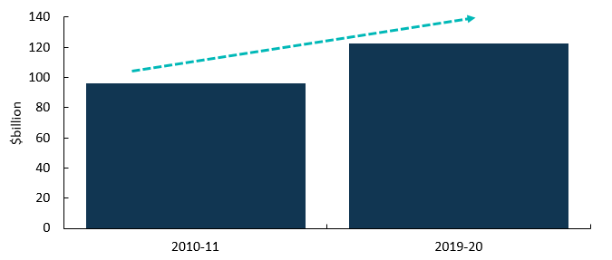
Cultural and creative activity in Australia 2010-11 to 2019-20
Key changes
Cultural and creative activity plays an important role in Australia’s economy, growing to $122.3 billion in 2019–‍20, an increase of $26.0 billion (27.1 per cent) over the last 10 years.
Cultural and creative activity refers to activities involving human creativity as a major input. While there is no universally accepted definition, the terms ‘cultural’ and ‘creative’ describe activities connected with the arts, media, heritage, design, fashion, and information technology.
This updated release quantifies the economic contribution of cultural and creative activity in Australia from
2010–11 to 2019–20.
This release covers the early economic impact of COVID-19 on cultural and creative activity. Social distancing measures and business restrictions were announced in March 2020, with the three-month period including April and early May 2020 also seeing a gradual easing of some restrictions across the country.
Chart 1: Cultural and creative activity, 2010–11 and 2019–20
Source: ABS Australian System of National Accounts, Australian National Accounts: Input-Output Tables; BCARR calculations

Slide 2
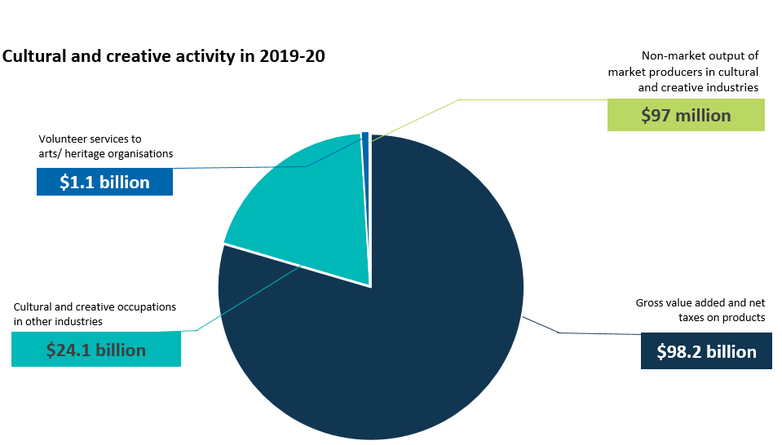
Key components of cultural and creative activity
On a satellite accounts basis, cultural and creative activity consists of four components:
Over 10 years, Gross Value Added (GVA) from cultural and creative industries increased by $18.7 billion to $93.4 billion in 2019–20
(25.0 per cent) and Net taxes on products attributable to cultural and creative industries increased by $252 million to $4.7 billion in 2019–20 (5.6 per cent).
Compensation of employees (COE) received by individuals working in cultural and creative occupations outside the cultural and creative industries was $24.1 billion in 2019–20. This grew by $7.1 billion over the period
(41.6 per cent).
The value of volunteer services to arts and heritage organisations was $1.1 billion in
2019–20, $230 million more than in 2010–11.
Non‑market output of market producers in cultural and creative industries was $97 million in 2019–‍20, an increase of $19 million compared to 2010–11.
Note: Satellite account is a term used to measure the size of economic sectors that are not defined as industries in national accounts. The ABS has developed satellite accounts such as tourism, non-profit institutions, and cultural and creative activity.
Chart 2: Components of cultural and creative activity in 2019–20
Source: ABS Australian System of National Accounts, Australian National Accounts: Input-Output Tables; BCARR calculations
The industry domains with the greatest contribution to activity in 2019–20 were design at $50.9 billion, fashion at $15.1 billion, literature and print media at $8.3 billion, and broadcasting, electronic or digital media, and film at $8.1 billion.

Slide 3

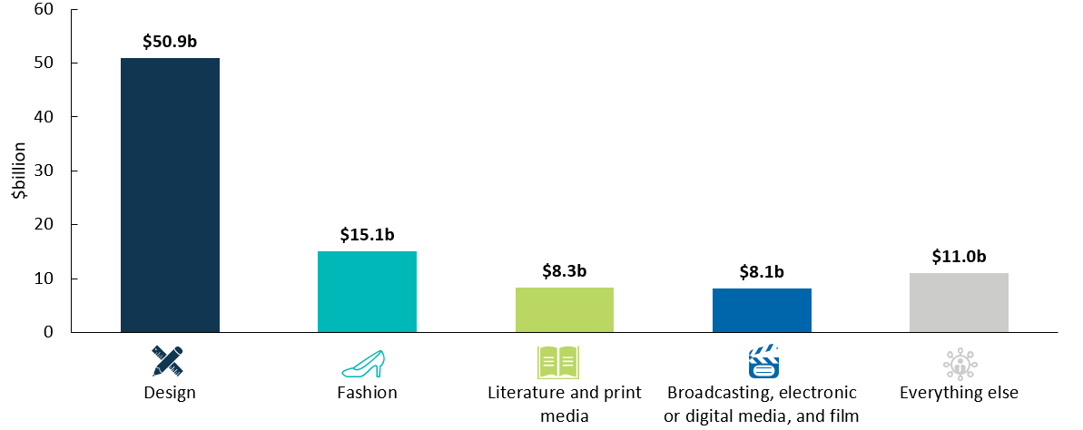

Gross Value Added of cultural and creative activity
Most cultural and creative industry domains grew in absolute terms over the 10-year period but did not keep pace with the economy as a whole.
Design activity grew strongly over the decade (↑$17.8 billion) and maintained its share of gross domestic product (GDP).
The growth was mainly driven by computer system design services, with an increase of 12.2 billion or 52.2 per cent over the decade. COVID-19 led more people to work from home from March 2020, leading to greater demand for cloud-based services across businesses.¹ GVA of computer system design services increased $3.1 billion or 9.6 per cent from 2018–19 to 2019–20.
Fashion activity also grew (↑$2.1 billion) over the 10‑year period but now makes up a smaller share of GDP. However, some cultural and creative industries in this domain such as clothing and footwear retailing experienced a large rise in May and June 2020, due to the gradual easing of social distancing regulations and the re-opening of physical stores between late April and early May 2020, with continued recovery from the trading restrictions during this period. ^{2,3}
Literature and print media activity (↓$3.9 billion) and broadcasting, electronic or digital media, and film (↓$163 million) declined both as a share of GDP and in absolute terms from 2010–11 to 2019‑20.
Chart 3: GVA by domain, cultural and creative industries, 2019-20
Source: ABS Australian System of National Accounts, Australian National Accounts: Input-Output Tables; BCARR calculations
The shrinking share of GDP for some domains partially reflects the structural changes occurring within these industries. For example, clothing manufacturing, printing and publishing have all faced increased global competition and are adjusting to automation and the shift from traditional print media towards digital content.
¹ IBISWorld industry report (2022), M7000 Computer system design services in Australia, April 2022, p. 17.
² Australian Bureau of Statistics (2020), Retail Trade, Australia, May 2020
³ Australian Bureau of Statistics (2020), Retail Trade, Australia, June 2020

Slide 4
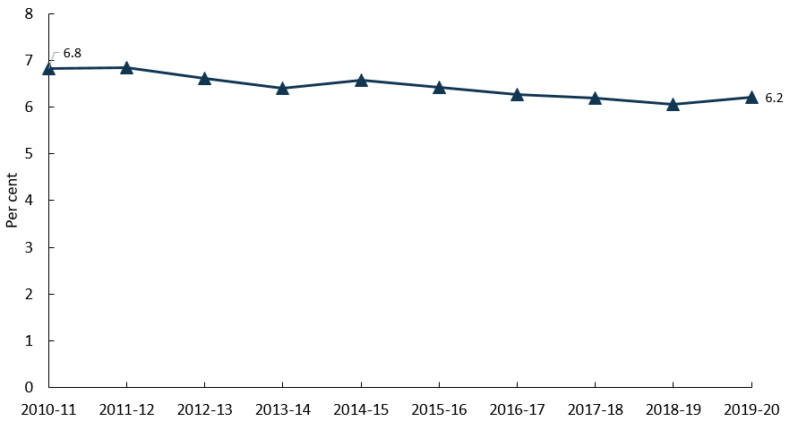
Cultural and creative activity share of GDP
Overall, growth in cultural and creative activity has been slower than the pace of growth for the Australian economy.
This largely reflects the continued strength in the mining sector, which falls almost entirely outside of cultural and creative activity.
As a share of GDP, cultural and creative activity declined by 0.6 percentage points, from 6.8 per cent in 2010–11 to 6.2 per cent in 2019–20.
Chart 4: Cultural and creative activity, share of GDP,
2010-11 to 2019-20
Source: ABS Australian System of National Accounts, Australian National Accounts: Input-Output Tables; BCARR calculations
About this document
The Bureau of Communications, Arts and Regional Research (BCARR) within the Department of Infrastructure, Transport, Regional Development, Communications and the Arts has estimated the economic contribution of cultural and creative activity in Australia over a 10‑year period, from 2010–11 to 2019–20.
This document outlines the key findings from the tables and figures shown in BCARR’s visual summary document: Cultural and creative activity in Australia, 2010–11 to 2019–20 and is presented alongside a document of Frequently Asked Questions. Unless otherwise noted, the 10-year period refers to 2010–11 to 2019–20.
Further information on the methods used in this research can be found in BCARR’s working paper: Cultural and creative activity in Australia, 2008–09 to 2016–17.

